Slide 1
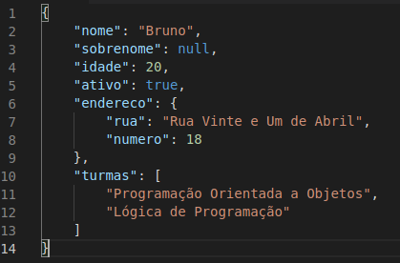
Pafúncio Soft
Zuleika Soft
APP 1
API
JSON
API
APP 2
Middleware
Middleware
Banco de Dados
Banco de Dados
.Net Core
C#
HTML / CSS / JavaScript
MySQL
Java
Bootstrap / JavaScript
Oracle

